Slide 1
Weekly update
Batbot hovering by means of evolutionary algorithm
安武
2023/03/26

Slide 2
TABLE OF CONTENT
Last Advancements
Current State
This Weeks Goals

Slide 3
Last advancements
Thorough Analysis of micro-controllers:
Arduino: Great for prototyping, more for DIY
Pixhawk: Good for drones, hard to program, no flapping support
STM32: Great for programming from scratch, powerful, professional
Conclusion: We will use STM32. More professional, easier to program, more control as it is closer to machine language and also because it is what Dr. Li uses and we better work with the same software.

Slide 4
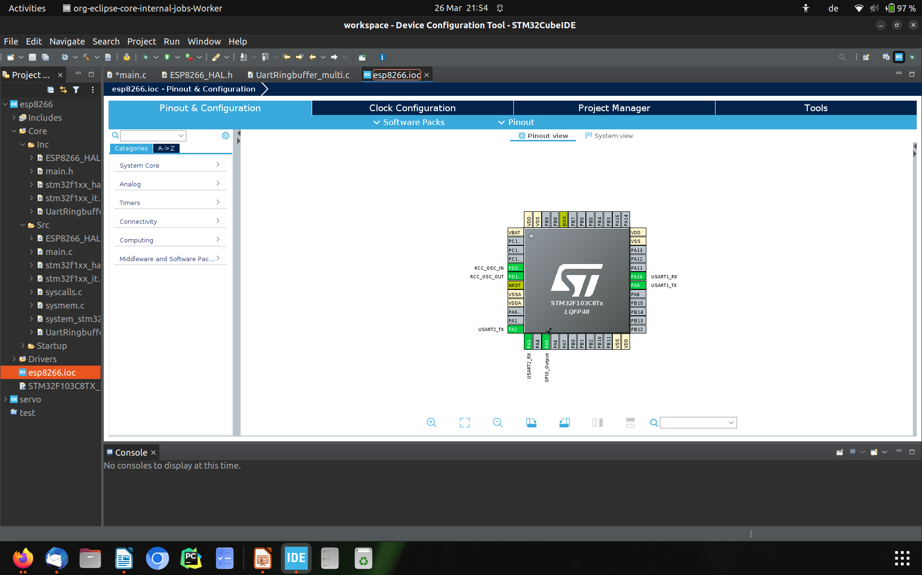
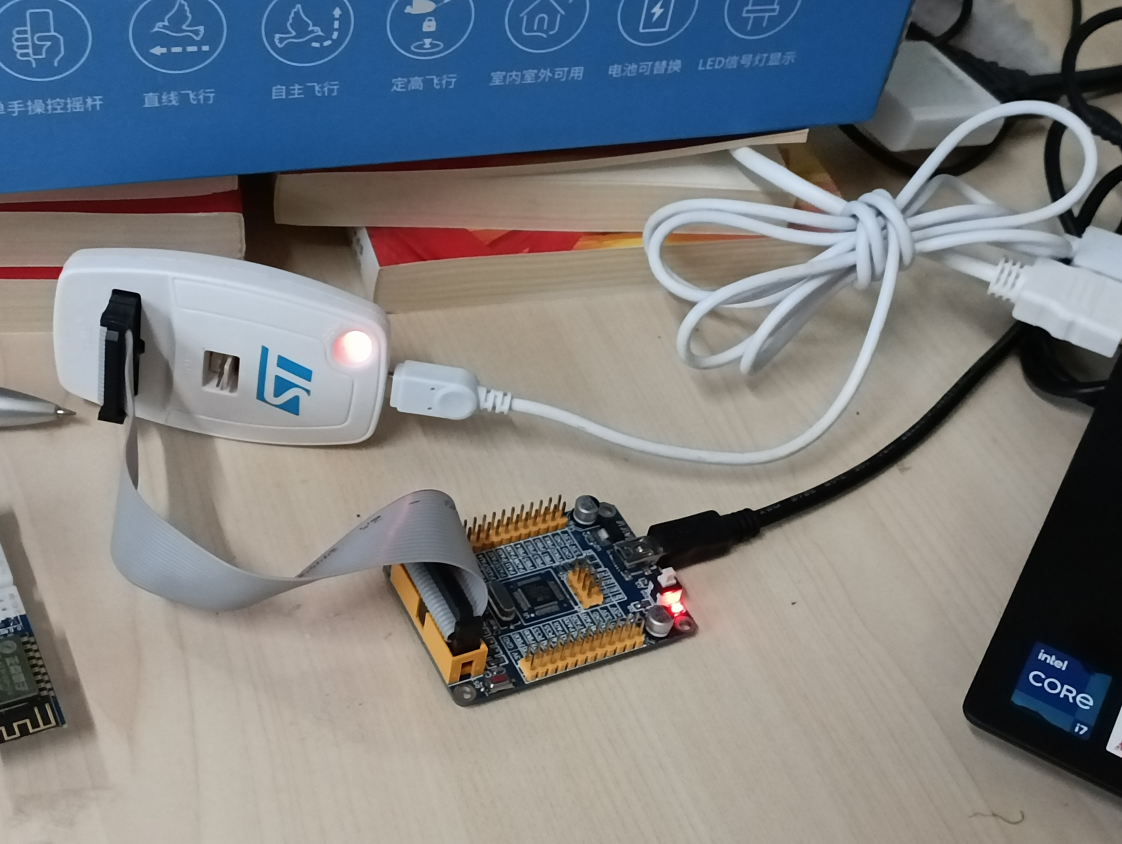
Last advancements
Learning STM32
Software Installation
First basic tests with STM32F103C8T6:
LED Blink
Servo control

Slide 5
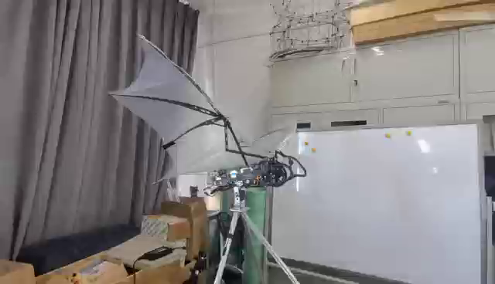
Last advancements
Test Bench Constructed and Working

Slide 6
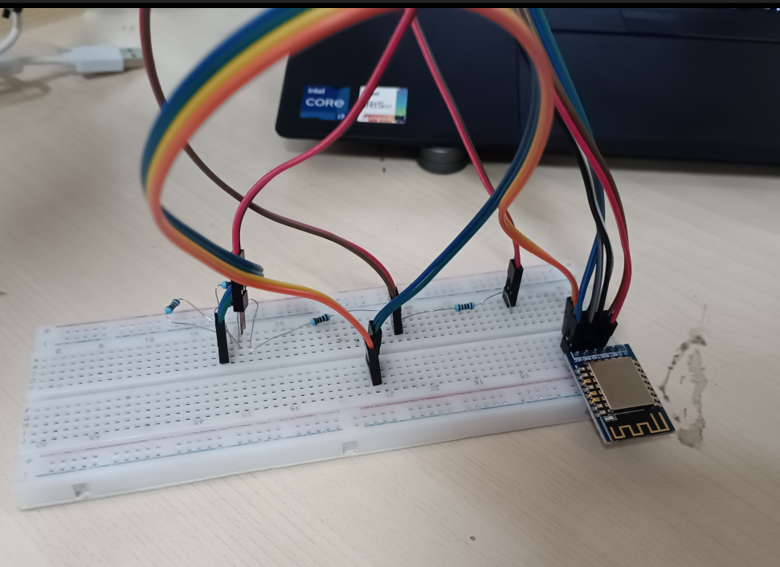



Current state
Creating Entire Workflow
Wireless connection
Understood ESP8266 from the core

Slide 7
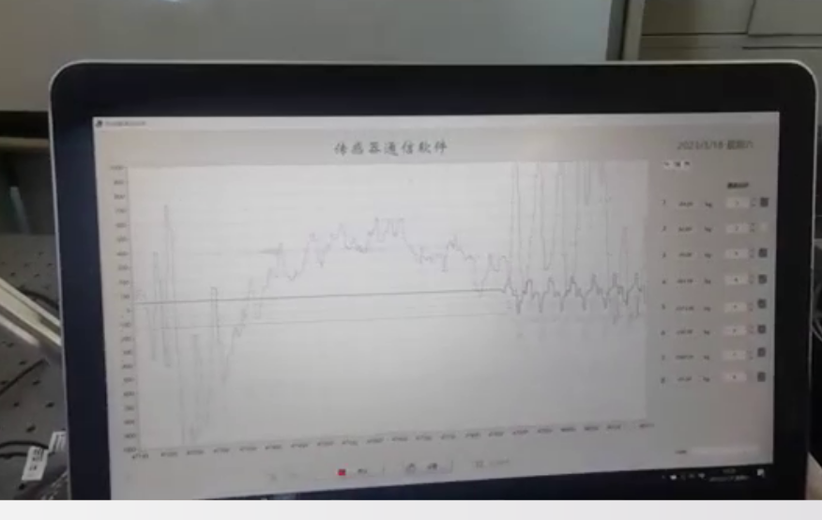
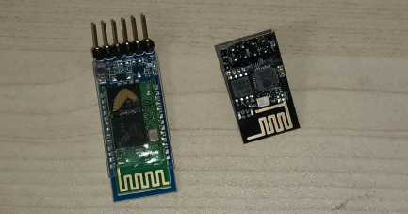
Week goals
Achieve wireless communication between Batbot and computer
Further experiment with ESP8266
Experiment with Bluetooth HC05
Automatically read data from Test-bench sensors
ESP8266 (WIFI)
HC05 (Bluetooth)

Slide 8
Thank you!

